Slide 1
Git & GitHub

Slide 2
Outcomes
Commit
Push
Pull
Clone
Fetch
Merge
Diff
Branching
Git GUI
Fork
.gitignore

Slide 3
Theory

Slide 4
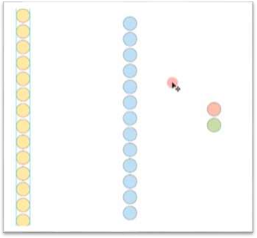
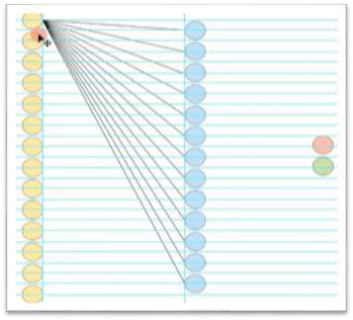
Git - Version Control System
▶ Version control is a system that records changes to a file or set of files over time so that you can recall specific versions later.
Design 1
Design 2

Slide 5
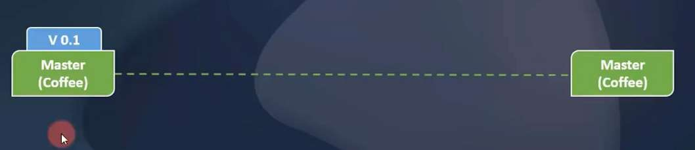

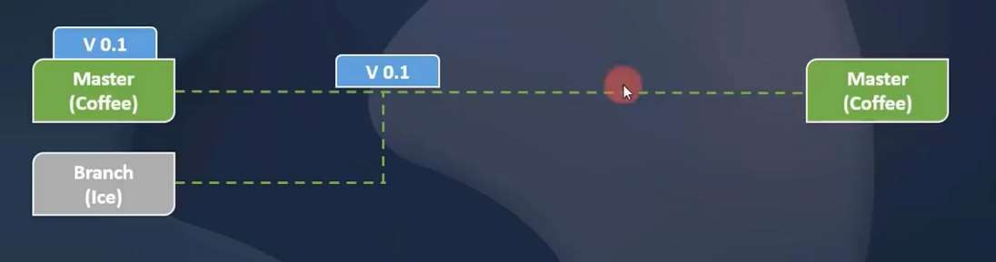

Branch
Master Branch
Branch 1

Slide 6
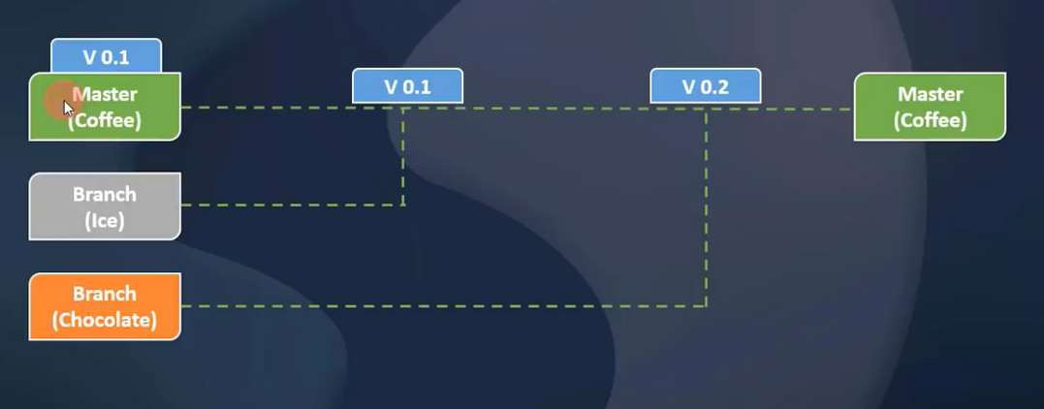

Branch
Contd..
Branch 2

Slide 7
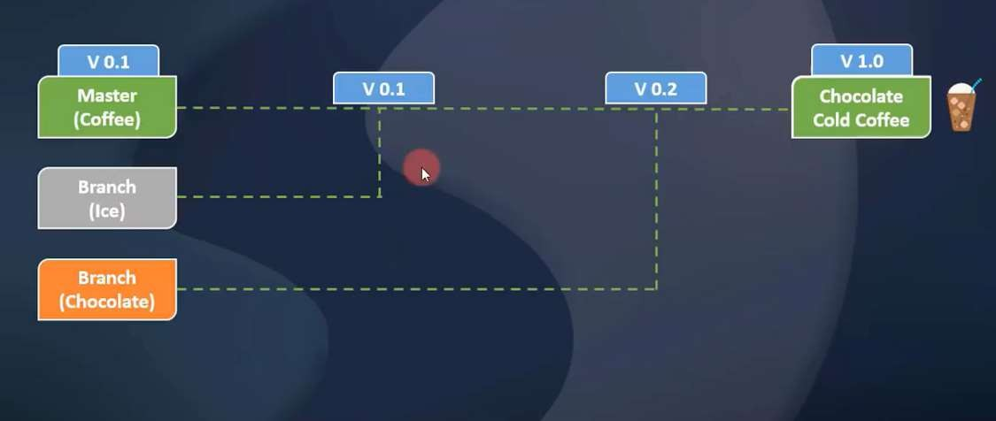
Contd..
Branch

Slide 8
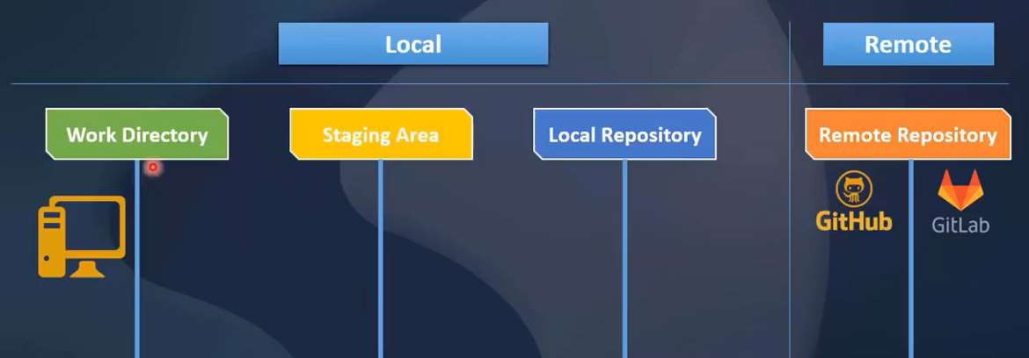
Repository

Slide 9
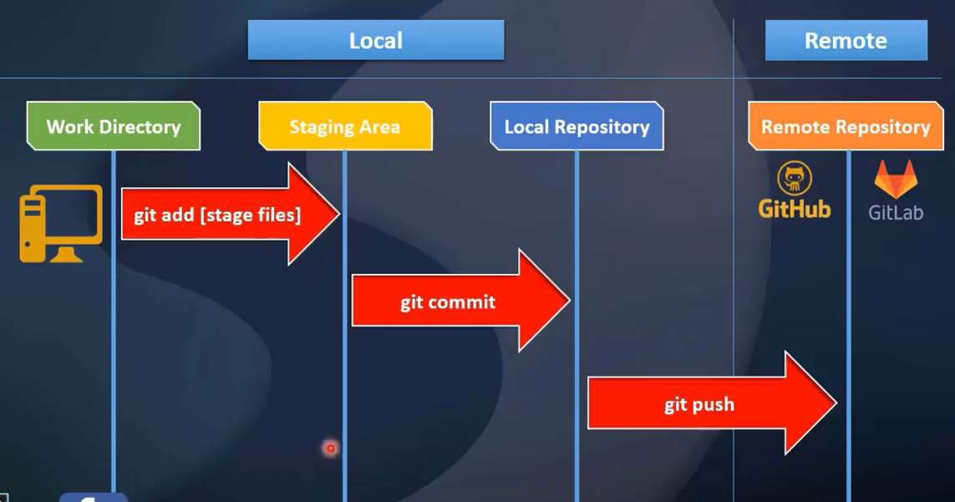
Contd..
Repository

Slide 10
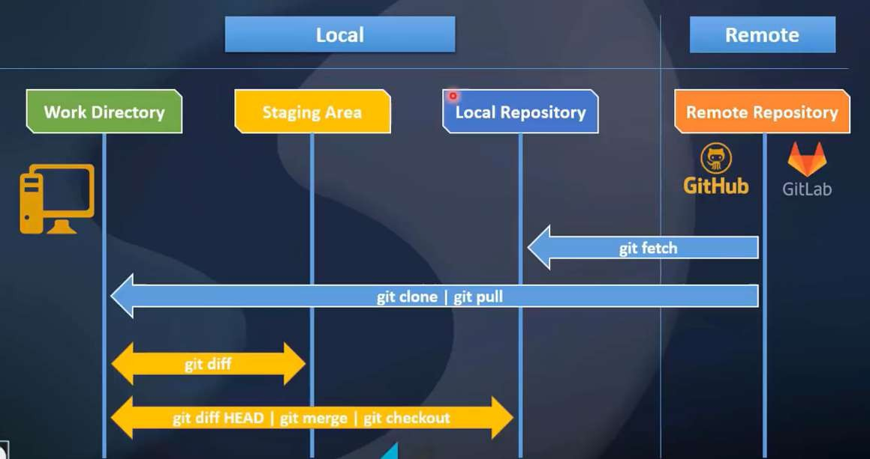
Contd..
Repository

Slide 11
Practical

Slide 12
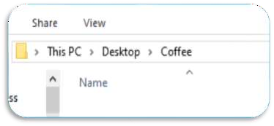
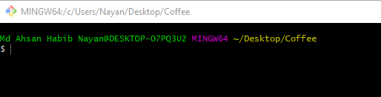
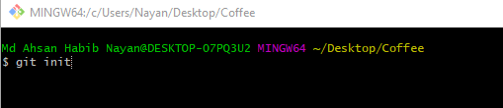
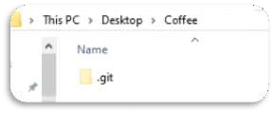
Initialization
▶ Create a folder in any directory. For example, I created a folder
named “Coffee” in my desktop.
▶ Then open Git Bash here.
▶ Then type “git init” for initialization.
▶ Now you can see “.git” folder in you “Coffee” directory.

Slide 13
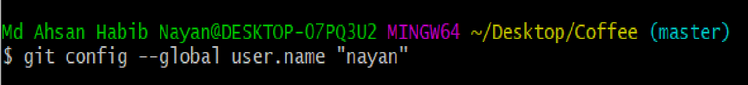

Configuration
▶ To set username globally:
git config --global user.name “nayan”
▶ To set email globally:
git config --global user.email “habib@cse.green.edu.bd”
▶ To set username and email locally: git config user.name “nayan”
git config user.email “habib@cse.green.edu.bd”
▶ Now type “git config --list” to show your configuration.

Slide 14
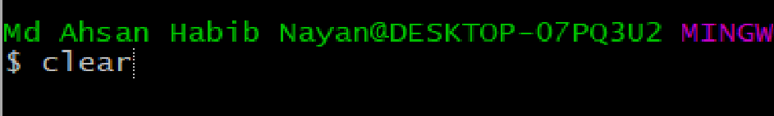
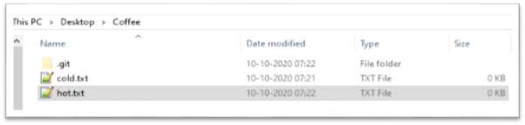

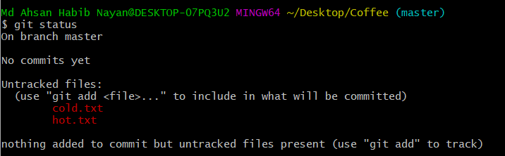
Commands
▶ To clear your screen just type: clear
▶ Let’s create two files in “Coffee” dir.
▶ cold.txt
▶ hot.txt
▶ Now type:
git status

Slide 15
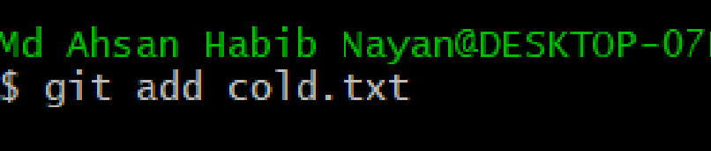

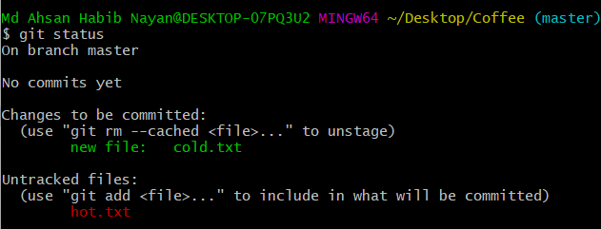
Commands
▶ Let’s use add command: git add cold.txt
▶ Now type:
git status

Slide 16
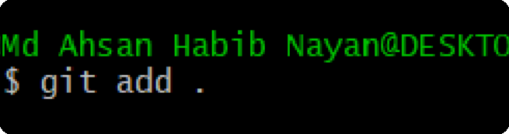

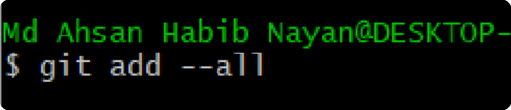


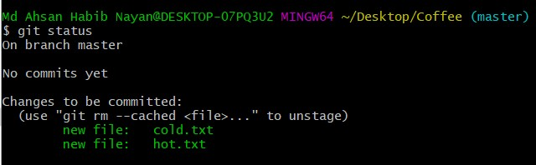
Commands
▶ Add all files using single command: git add --all or
git add .
▶ Now type:
git status

Slide 17
Commit

Slide 18
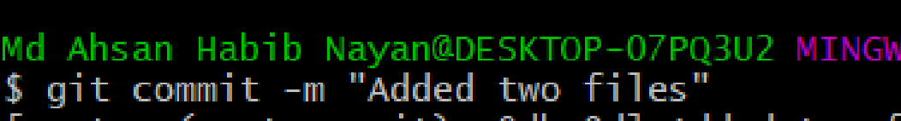



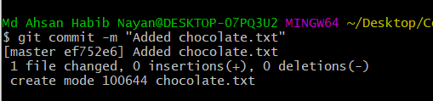
Commit
▶ Staging area to Local repo:
git commit –m “Added two files”
▶ Now type:
git status
▶ Let’s commit again:
▶ First create a file “chocolate.txt” in “Coffee”.
▶ Now add this file.
▶ Then commit.

Slide 19

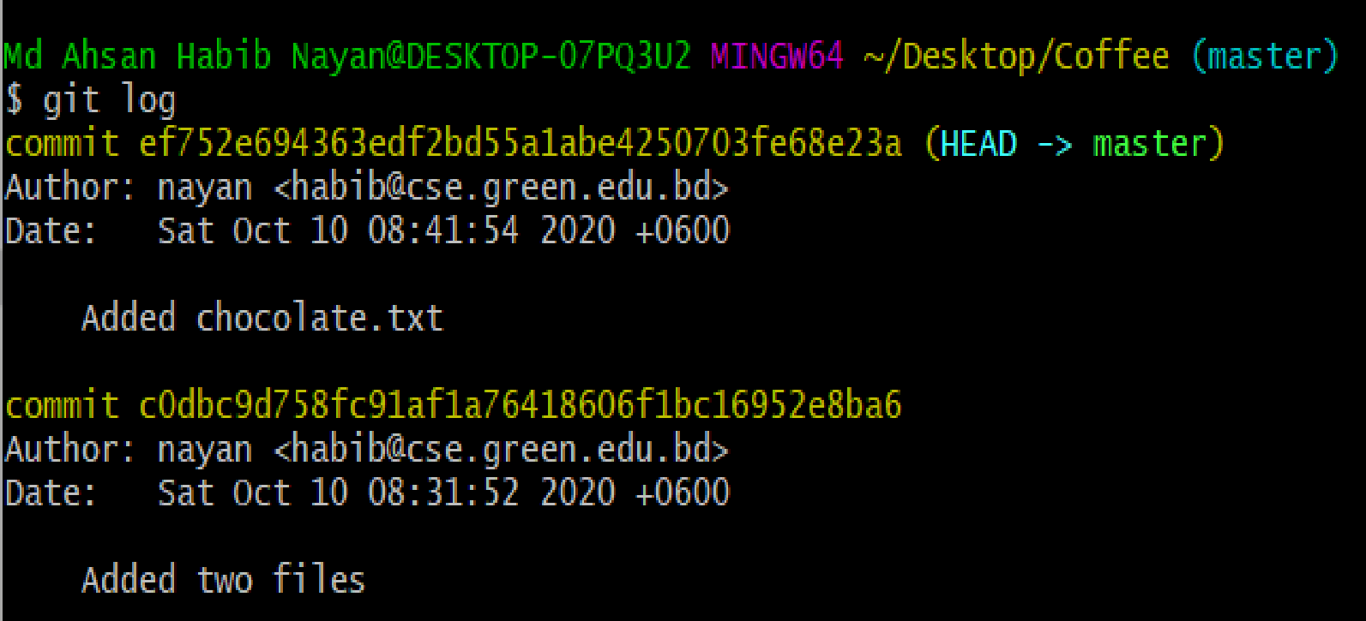

Commit
▶ To show our commit: git log
▶ Another way [Simple]: git log --oneline

Slide 20
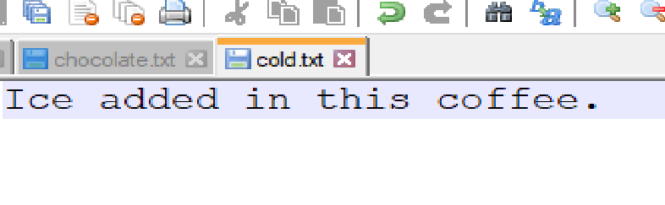
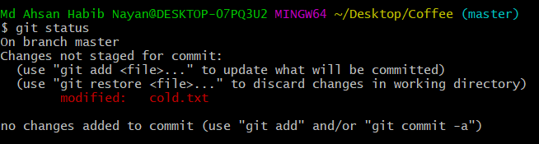

Commit
▶ Let’s write something in cold.txt file.
▶ Now type:
git status
▶ Let’s commit again:
▶ Add the changed file [cold.txt].
▶ Then commit.
▶ Now use git log command to show commits.

Slide 21
Checkout

Slide 22


Checkout
▶ Let’s we need to go back our previous version of cold.txt.
▶ Can we do that?
▶ Yes, It’s simple. Just use checkout command.
▶ To do this.
▶ First log the commits.
▶ Then use checkout using commit id.
▶ You can see that you cold.txt file got empty again.
▶ Note: we are not in master branch now.

Slide 23


Checkout
▶ Let’s use git log again. You can see there are only two
commits exist.
▶ Can you switch one of the commit-ids ?
▶ Have a try ☺
▶ Let’s back to our master branch.

Slide 24
Diff

Slide 25
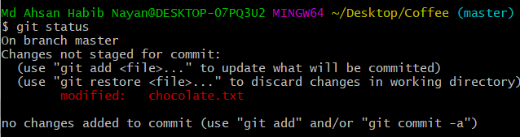
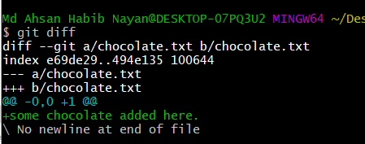
Diff
▶ Let’s compare two files. We have to use git diff command.
▶ To do this.
▶ First add some text in chocolate.txt.
▶ You can use git status to show if chocolate.txt changes or not.
▶ Then use git diff comman.
▶ You can see the changes.
▶ Note: git diff always works between latest changes.

Slide 26
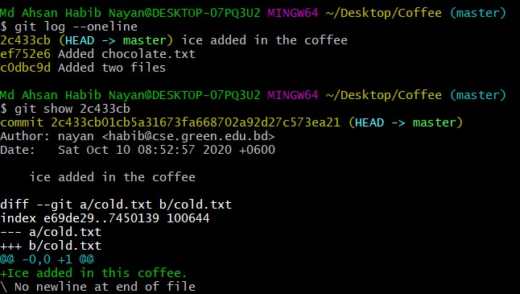
Diff
▶ To show changes at a particular commit you can use git
show with commit-id.

Slide 27
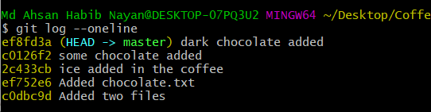
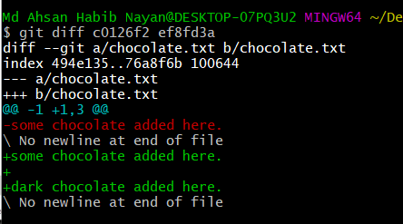
Diff
▶ We haven’t add the updated chocolate.txt file yet. Just
add this file. Then commit it.
▶ Now we again added some text in chocolate.txt file. Then add and commit it.
▶ Using git log you can see like this.
▶ Now we want to show differences between two chocolate.txt files [previous and current].
▶ To do use use git diff with two commit-ids. git diff id1 id2

Slide 28
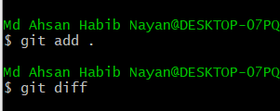
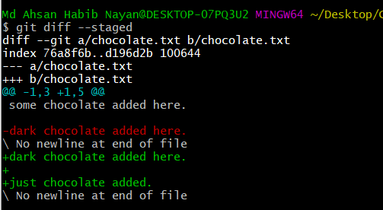
Diff
▶ What if we want to see the differences in the staged
section ie. Afer adding and before commit.
▶ Use: git diff --staged
▶ To do this:
▶ Update chocolate.txt again. Use git diff to show changes.
▶ Now use git add command. If you want to show changes now and use git diff command it shows nothing.
▶ To show changes use: Git diff --staged

Slide 29
Remove

Slide 30
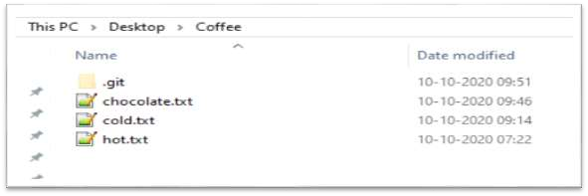


Remove file
▶ How can we delete a file?
▶ If you delete from “Coffee” directory then it is removed from current stage [not all commits].
▶ What if we want to delete permanently ie. delete a file from all commits ?
▶ We have to use: git rm file_name
▶ It deletes the file from all commits.
▶ If we run git status then we can see that the hot.txt file is in staged section. If we want to delete from staged section then we have to use: git reset HEAD hot.txt. Now again run git status command to see the chages.

Slide 31
Let’s Store/Push the files into Remote Repository!!

Slide 32
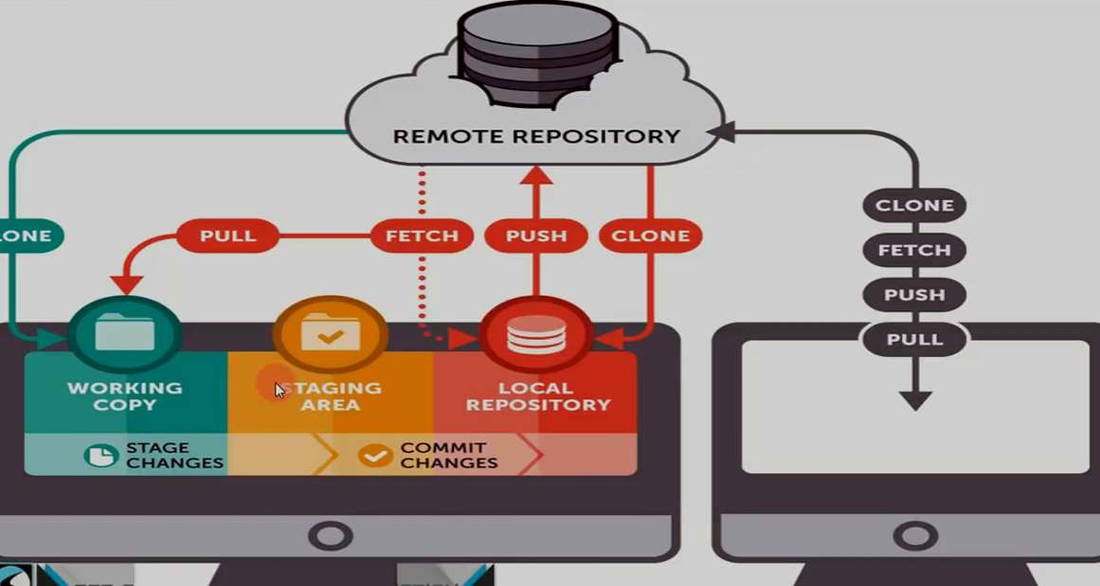
Full System Pictorial View

Slide 33
Push
▶ How can we push the files into Remote Repo?
▶ To do this:
▶ We need to have a github account.
▶ Now let’s create a Repository.
▶ Then follow some steps.
▶ Copy the remote repo link and run in the Bash Terminal.
▶ Use push command.
▶ Now refresh your repo.
▶ Let’s see graphically.

Slide 34
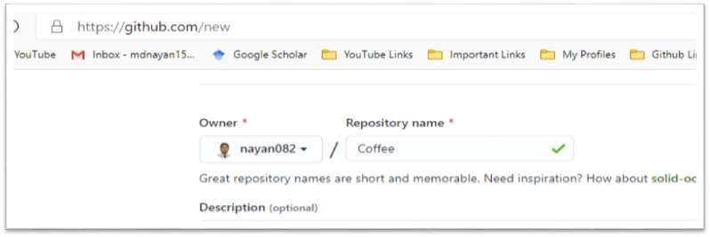
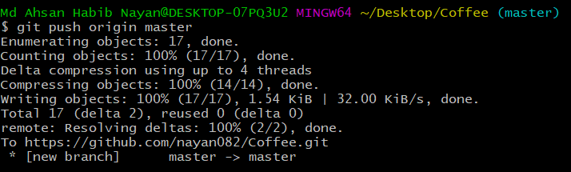
Push
▶ First, create a repository.
▶ Then copy the link (remote repo) and run.
▶ Now run push command. git push origin master or git push –u origin master

Slide 35

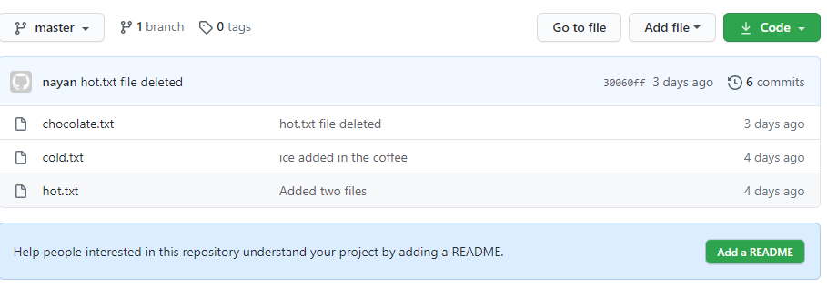

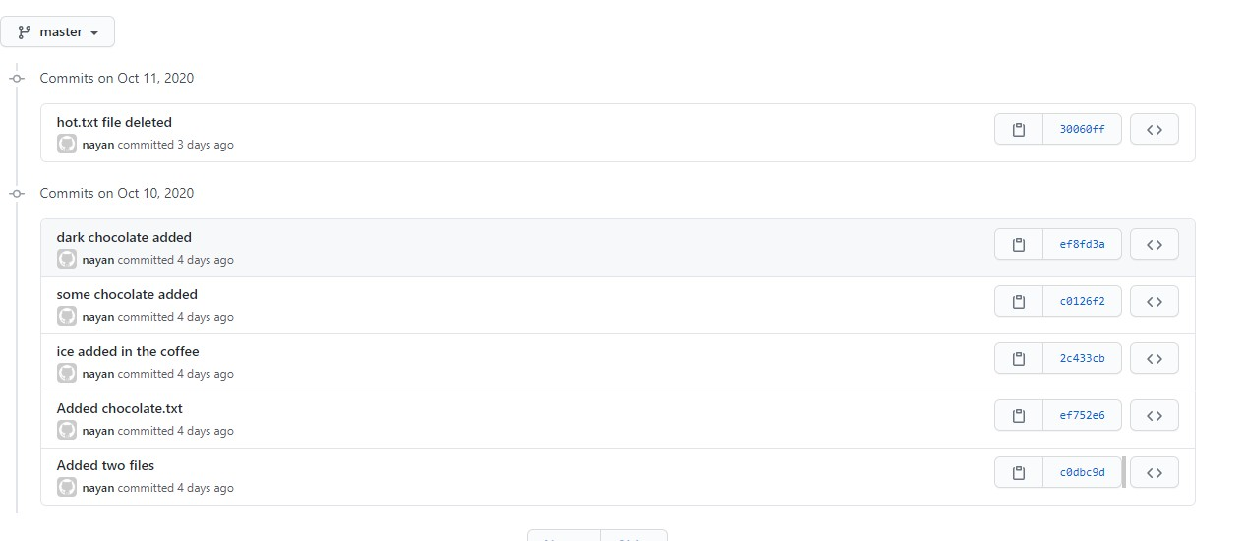
Repository
▶ We can see here all commits
we have done.
▶ And we can go back any stage of those commits.

Slide 36
Download/Clone from Remote Repository!!

Slide 37

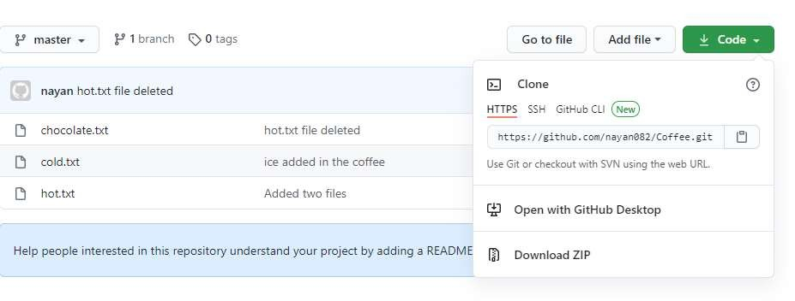
Clone
▶ How can we download/clone the projects into Remote Repo?
▶ To do this:
▶ We can download as a zip or
▶ We can clone the repo.

Slide 38
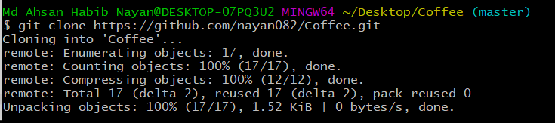
Clone
▶ To clone the repository copy the project link and run the command: git clone repo_link
▶ The folder named with the repository name.
▶ If you want to assign a different name use: git clone repo_link new_name

Slide 39
Fetch

Slide 40

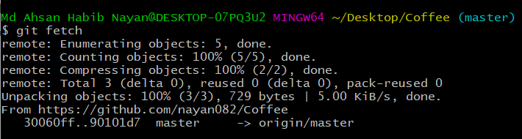
Fetch
▶ First, let’s change cold.txt file (add a line into cold.txt) and make a commit (from remote repo).
▶ To fetch the repository we use:
git fetch

Slide 41
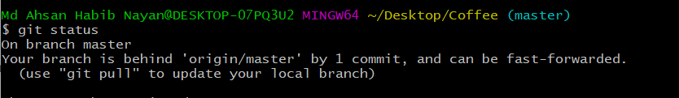
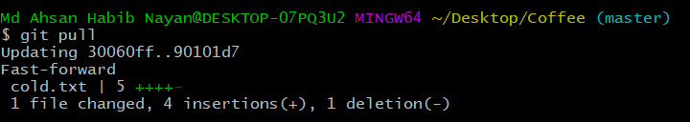
Fetch
▶ Now run git status to see the commit.
▶ Now let’s check the cold.txt file. Can you see any update ?
▶ No. Our machine only know that something changes. And they suggest us
to use git pull command.!!
▶ Now use: git pull. Now check the cold.txt file.

Slide 42
Branch

Slide 43

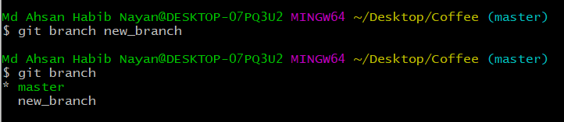
Branch
▶ To create a branch we use: git branch branch_name
▶ To check how many branch we have: git branch
▶ * Sign represent the current branch.

Slide 44

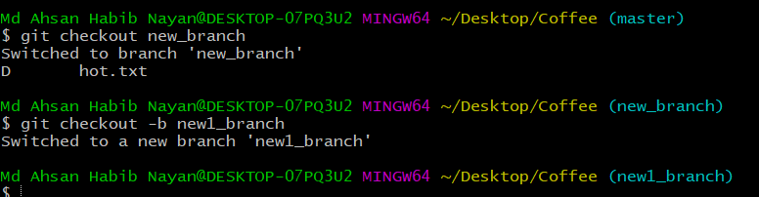
Branch
▶ To switch a branch we use:
git checkout branch_name
▶ We can create and switch at a time to the branch using: git checkout -b branch_name

Slide 45
Branch
▶ Now we are in “new1_branch”. Anything changes in the Coffee repository, the changes will be happen in the new1_branch not affects other branches(master, new_branch).
▶ Let’s create a file in the current branch (new1_branch) and use git add and commit command.
▶ If you switch to master branch, you can see the changes in the Coffee repo.

Slide 46
Merge

Slide 47
Merge
▶ If you want to merge/add all the changes in the master branch. You can run:
git merge new1_branch
▶ By running this you can see the changes happen to the master branch.

Slide 48

Delete a Branch
▶ If you want to delete a branch. You can run: git branch -d branch_name

Slide 49
GitIgnore

Slide 50
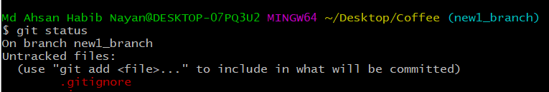
Git Ignore
▶ If you want some files do not need to be commit or add we can make a list of them into “.gitignore” file.
▶ Let’s first create a file which should be ignored (ex: no_need.txt).
▶ Now we need to create “.gitignore” file and write no_need.txt inside it. Now run git status, you can see that the no_need.txt file not be tracked.

